Slide 1
C.4 Virus Summary Notes

Slide 2

What Is A Computer Hacker?
News & Popular Definition
A person who writes computer viruses
A person who commits criminal activities
Definition In The Computer Community
A Person who has deep knowledge / Skills
A person who works hard to do difficult things
A person who shares information for the common good
What was a Badge of Honour has been turned into a Slander

Slide 3
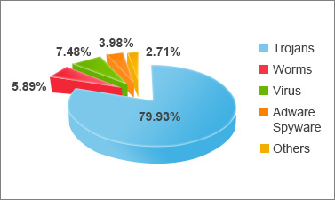
Types of Computer Malware
Virus
Worm
Trojan Horse

Slide 4
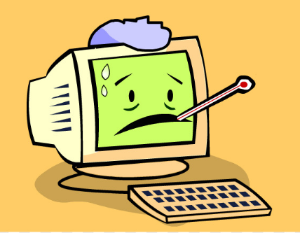
Computer Viruses
How do people catch a virus (like a cold)?
You touch something that is infected
The virus is just hanging around waiting for you
Computers… The same thing
Virus code is embedded in a file / email / website
Virus waits for you to bring it to your computer
Viruses can be defeated by Good Hygiene
Don’t click on or download suspicious things

Slide 5
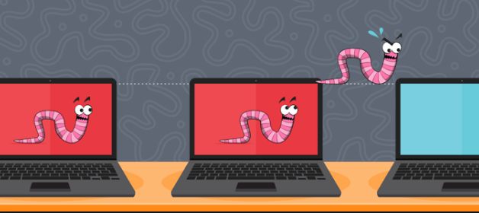
Computer Worms
What do real worms do?
They crawl around in dark places
They look for holes and ways to eat into things
Computers… The same thing
Worms look for weaknesses in your computer
Worms crawl around the internet
Worms Require Detection & Removal Tools
Active Firewalls & Anti-Virus Software

Slide 6
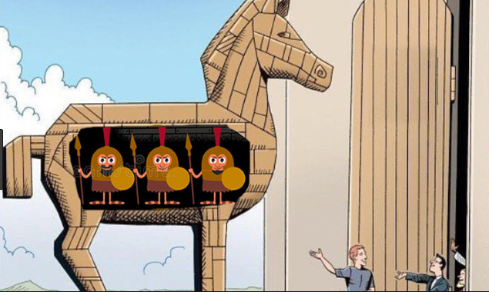
Trojan Horse
Named after an Ancient Greek Myth?
The battle of the city of Troy
Soldiers hid in a wooden horse
They were brought into the city because the horse looked like a present
Computers… The same thing
Provides a “back door” entry into computers
Is activated to install more damaging malware
Trojans Require Detection & Removal Tools
The Trojan lies inactive and undetected until needed

Slide 7
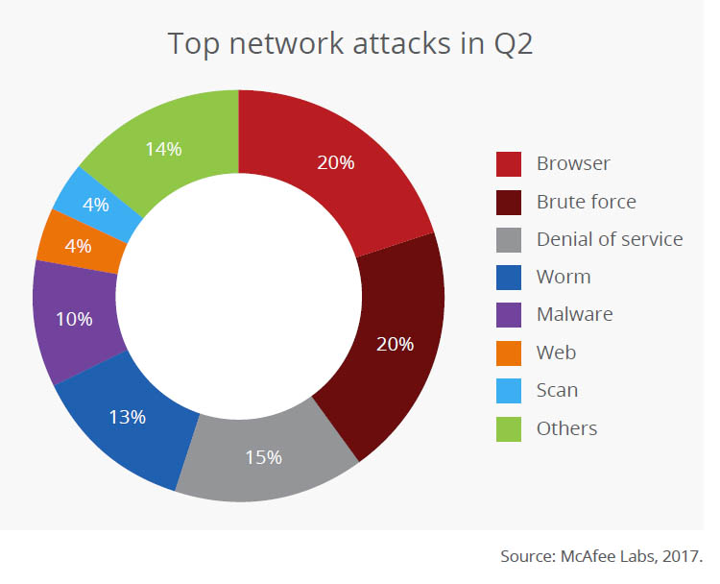
Types of Attacks
BIOS / Boot Sector
Buffer Overflow
Denial of Service (DoS)

Slide 8
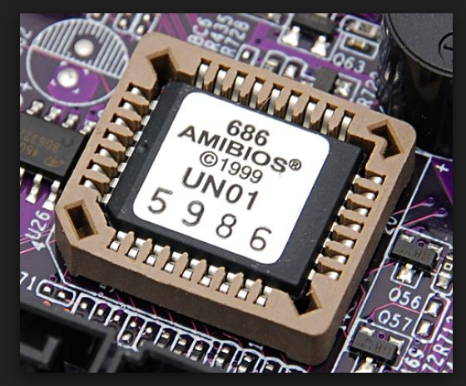
BIOS / Boot Sector
BIOS – Basic Input / Output System
The firmware loaded on your motherboard
Controls access to CPU / Memory / Disk Drives
Boot Sector
Space on your hard drove that contains your operating system (Windows)
Is the program that loads Windows and other application software
Infection will load before any Firewalls or Anti-Virus Software
Very Difficult to remove
Requires Running in Safe Mode

Slide 9
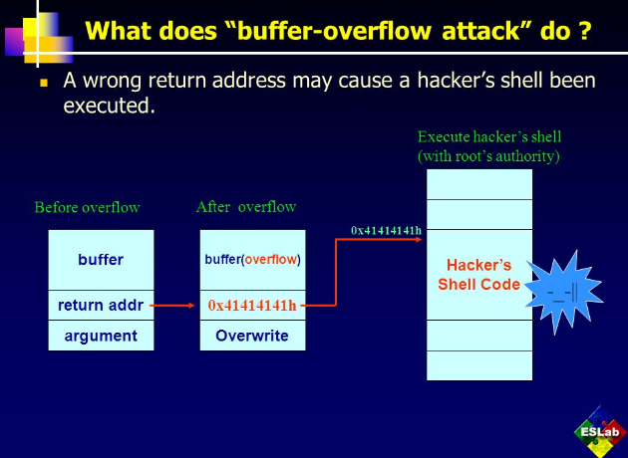
Buffer Overflow
Triggers a Software Error in a Normal Program
Normal Program is Tricked into running virus software
Exploits weaknesses unknown at development time

Slide 10
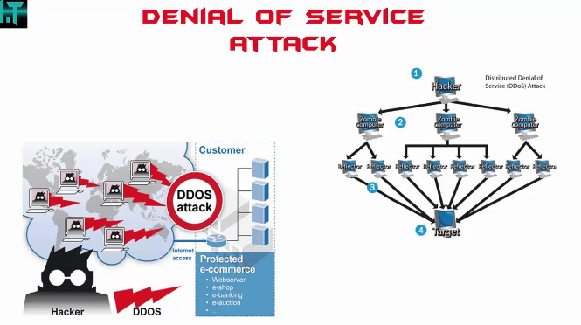
Denial of Service (DoS)
Causes Heavy Internet Traffic
Email or web page requests
Target Computer Must Spend All Of Its Power Handling Attack Requests
Target Computer Slows Down Servicing Of Services

Slide 11
Methods of Entry
Email / Website
File Download / Torrent
Firewall

